Slide 1
Then and now
On equal terms
Healthwatch Tower Hamlets Annual Report 2020-21

Slide 2
Contents
Executive Summary 3
Message from our Co Chair 4
About us 5
Highlights from our year 6
Then and Now
Healthy communities 7
Health inequalities 9
Urgent care access 11
Young people 13
Our Community Insights Reports 14
Volunteers 15
Finances 17
Next steps and thank you 18

Slide 3
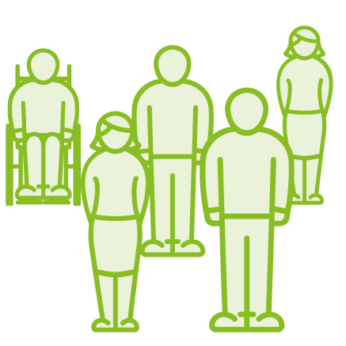
Executive Summary
Community insights
Over 4,000 local people shared their experience of health and social care services. We used these to inform our 20 reports; making 128 recommendations for service improvement across public, primary, social and hospital care.
We led a Covid community insights project with our eight neighbouring Healthwatch for the North East London Integrated Care System. This has gathered nearly 60,000 issues and is seen as a national model of innovation.
Urgent Care Access
Covid made our work on improving access to care even more important. As GPs worked remotely and increased digital appointments, we looked at the impact on different groups within our communities.
Our insights helped GPs and hospitals adapt their systems quickly and helped them to train their staff to identify and address likely inequalities as they arose.
Health inequalities
Our work into what makes a healthy community increased understanding of the factors impacting on inequalities locally.
Professor Sir Michael Marmot led our webinar on inequalities and Covid. We presented evidence to the Tower Hamlets local Inequalities Commission supporting their recommendations.
Our recommendations informed the new Borough Health and Wellbeing Strategy.
What next?
We will support the health and social care system to build back better by asking local people what changes, due to Covid, should be kept and which ones should be removed.
We want to put local residents at the heart of redesigning services and providing them with ongoing community insights to support them in that role.

Slide 4
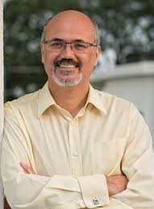
Message from our Co-Chair Randal Smith
Changing what we do and how we do it in a time of crisis
The pandemic has been a challenge for all of us. Like others, we had to change the way we worked – from the office arrangements to public consultations. We decided the most useful role we could play was to feed residents’ insights to the health and social care services to enable them to respond quickly. Our staff and volunteers moved from face-to-face working to engaging with people over the phone or online. Their work was turned into reports and regularly informed the Borough’s pandemic response.
User voice and health inequalities
In the autumn, we hosted an online talk by Sir Prof Marmot who has made health inequalities central to public health thinking over the last decades. He emphasised the value of user voice in addressing the inequalities. Pointing out that the barriers to equality cannot be identified and removed without it.
Our reports described the unequal impact of lockdown on residents and made recommendations on how to respond now, and in the longer term, to address these inequalities.
Making a difference
I’ve been on the Board of Healthwatch Tower Hamlets for 5 years and would not have remained if we were not making a difference. That’s what we’re here to do. Drawing upon our report on home care, Tower Hamlets is redesigning its service. This process is just underway and we will engage further with the service providing further insights to improve it.
…and finally
The engine of Healthwatch Tower Hamlets is our volunteers – those conducting our surveys, coding and inputting the insights gathered, representing patients and users and sitting on the Board. They ensure we remain rooted in the community and reach the under-represented voices. I’m both delighted and proud that many of our volunteers draw on their experience with us to progress in employment for themselves.
I would urge you to consider joining us to help improve care in our Borough. Please contact us on 0800 145 5343, info@healthwatchtowerhamlets.co.uk

Slide 5
About us
Here to make health and care better
We are the independent champion for people who use health and social care services in Tower Hamlets. We’re here to find out what matters to people and help make sure your views shape the support you need, by sharing these views with those who have the power to make change happen.
Helping you to find the information you need
We help people find the information they need about services in their area. This has been vital during the pandemic with the ever-changing environment and restrictions limiting people’s access to health and social care services.
Our goals
Supporting you to have your say
We want more people to get the information they need to take control of their health and care, make informed decisions and shape the services that support them.
Providing a high quality service
We want everyone who shares an experience or seeks advice from us to get a high quality service and to understand the difference their views make.
Ensuring your views help improve health & care
We want more services to use your views to shape the health and care support you need today and in the future.
“Local Healthwatch have done fantastic work throughout the country during the COVID-19 pandemic, but there is more work ahead to ensure that everyone’s views are heard. COVID-19 has highlighted inequalities and to tackle these unfair health differences we will need those in power to listen, to hear the experiences of those facing inequality and understand the steps that could improve people’s lives.”
Sir Robert Francis QC, Chair of Healthwatch England

Slide 6
Highlights from our year
Find out about our resources and how we have engaged and supported people in 2020-21.
Access
We heard from
4,071 people
this year about their experiences of health and social care. They left 4,983 comments relating to 15,129 issues.
We provided advice and information to
146 people
this year.
Responding to the pandemic
We engaged with
857
People directly during the COVID-19 pandemic this year.
We made 86 recommendations on how providers could respond to the pandemic based on our community insights.
Making a difference to care
We published
20 reports
about the improvements people would like to see to health and social care services. From this, we made 128 recommendations for improvement.
75% of recommendations
we made last year have been acted upon, at the point where we reviewed progress.
Health and care that works for you
103 volunteers
helped us to carry out our work. In total, they contributed 483 hours.
We employ 4 staff
three of whom work full time and one 4 days a week, which is an 16% decrease from the previous year.
We received
£179,716 in funding
from our local authority in 2020-21, the same as the previous year.

Slide 7
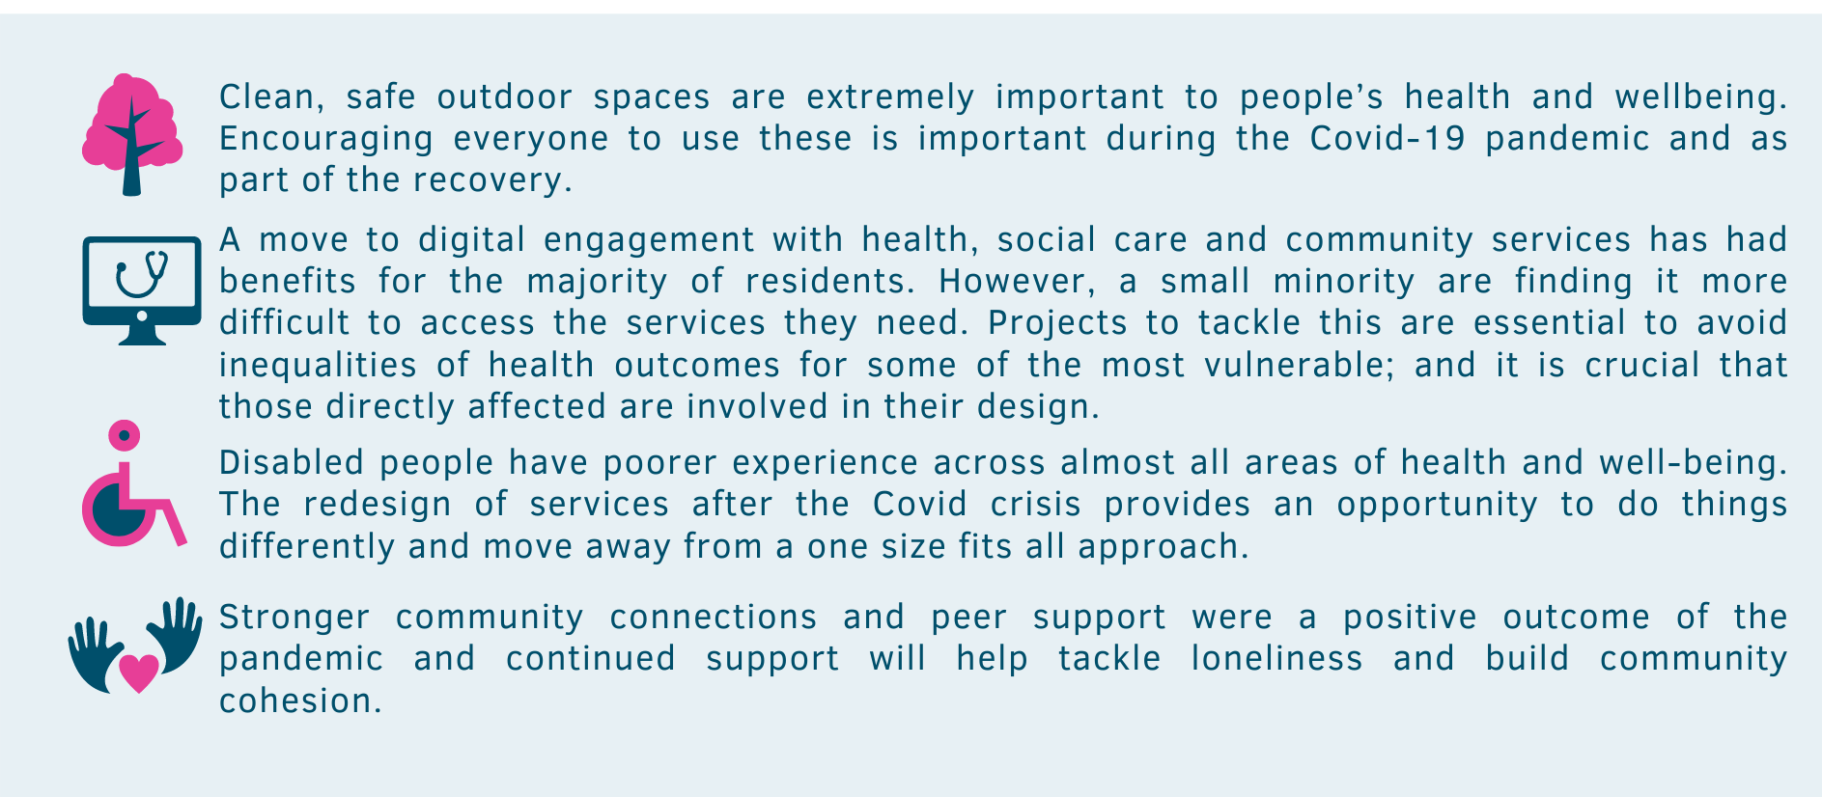
Then and now | Healthwatch Tower Hamlets | Annual Report 2020-21
Healthy communities: then and now
What local people say?
We have been asking local people key questions about staying healthy since 2019.
Asking the same questions prior to and during the pandemic allowed us to let local and regional services know what was important during Covid:

Slide 8
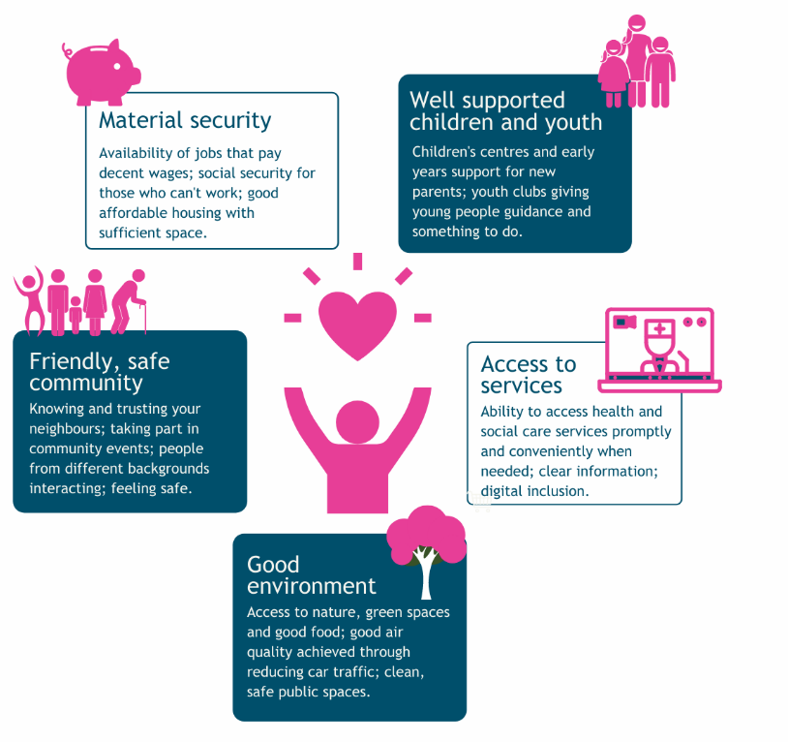
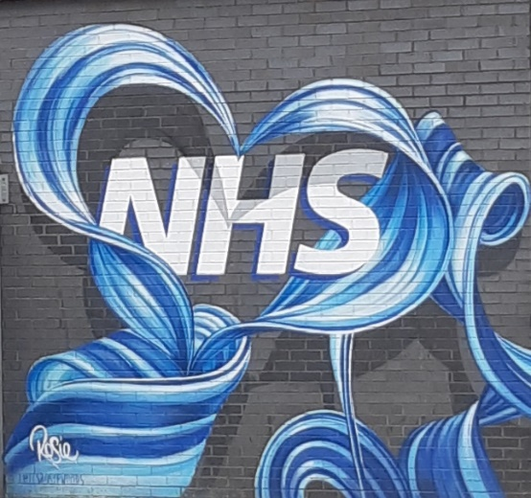
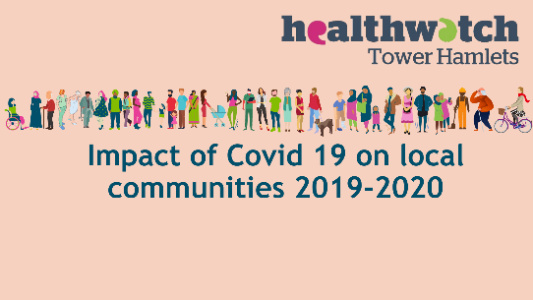
What does a healthy community look like?
As we build back from the pandemic the things that are important to residents are:.
“Feeling alone and completely friendless. During my sickness I needed company of my relatives and friends but for this pandemic situation completely changed. Very depressive situation. It has impacted on my mental health.” Local Resident
What difference did we make?
Our community insights on the pandemic meant that services adapted quickly including prioritising keeping parks open and safe, linking to online community groups to get Covid messages out, linking up information and advice with GP services.
The new Borough health and wellbeing strategy has prioritised safe open spaces, children, young people and improving access and coordination of services based on our findings.
Click on the image to read the full report.

Slide 9
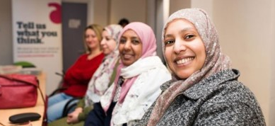
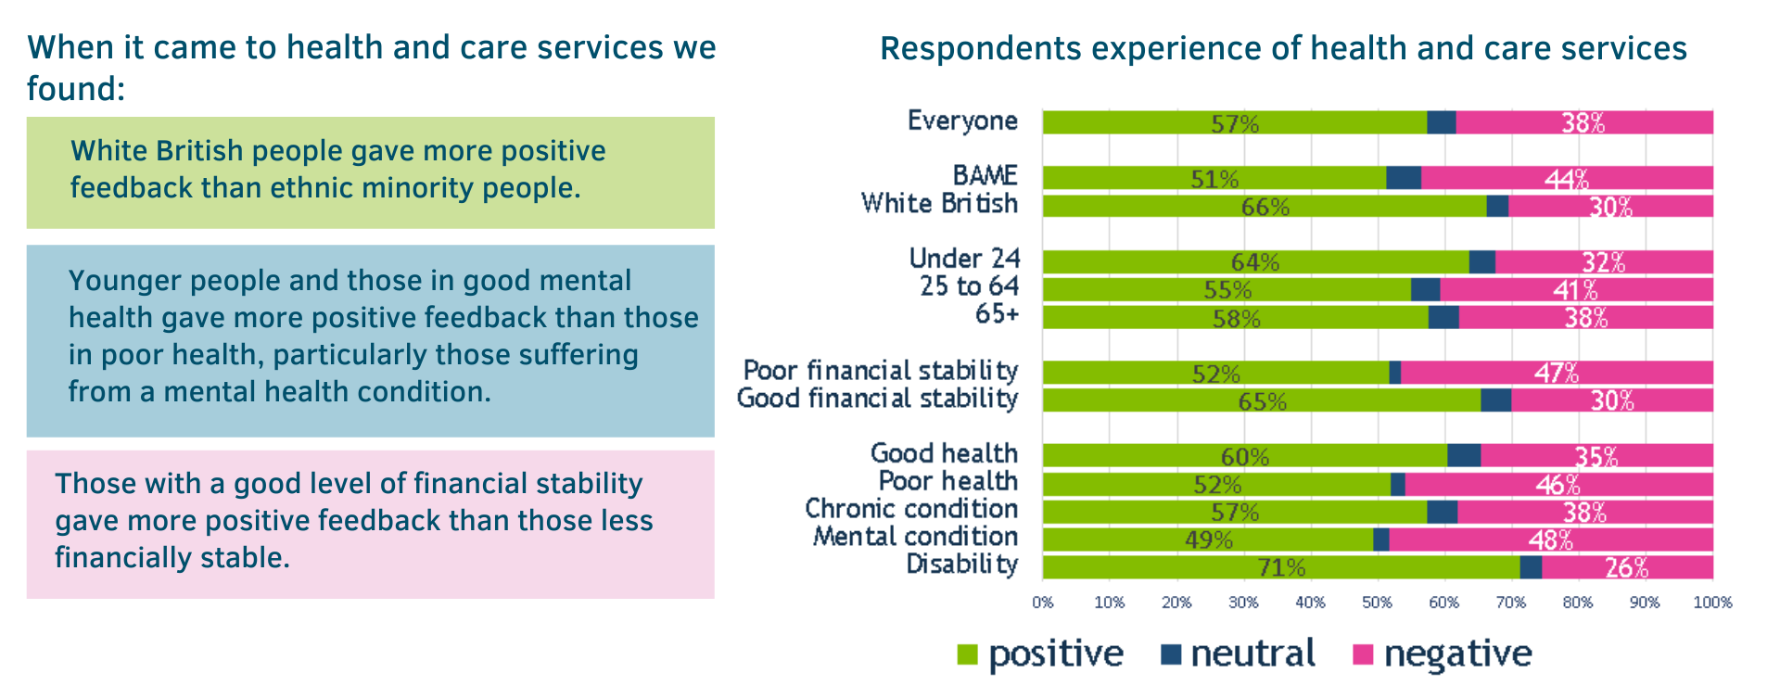
Then and now | Healthwatch Tower Hamlets | Annual Report 2020-21
Health inequalities: then and now
Who struggled to stay healthy before the pandemic?
354 Total respondents

Slide 10
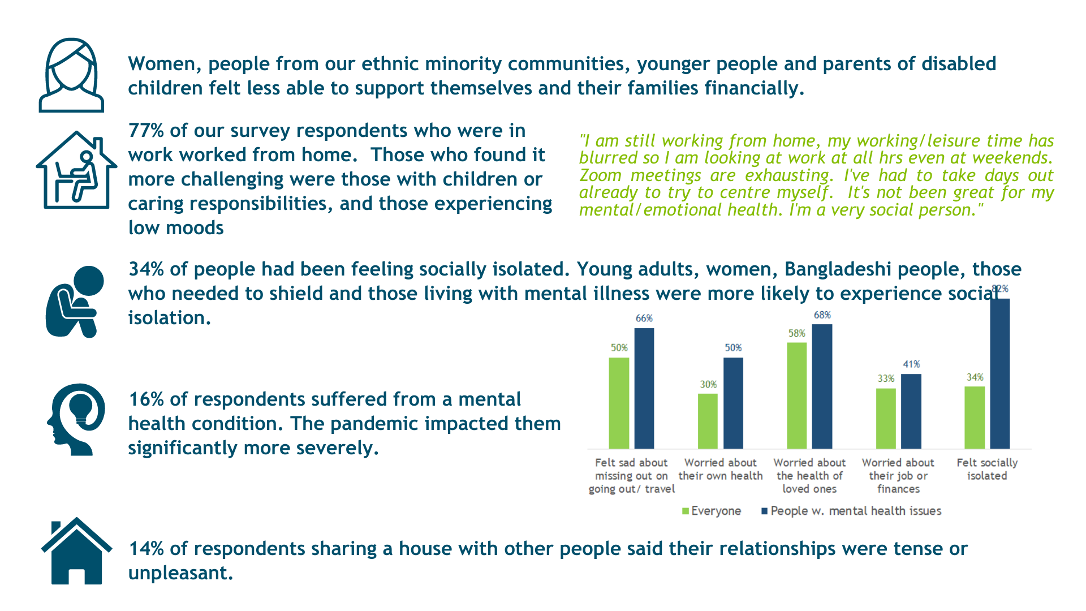
How did Covid impact inequalities?
354 Total respondents
What difference did it make?
Our Health Inequalities Webinar with Sir Professor Michael Marmot was attended by over 200 stakeholders from across the local health and care system. You can view it here. Inequalities with Sir Prof Marmot. The outcome of discussions fed into the Health and Wellbeing Strategy.
We provided key intelligence to the Tower Hamlets Black, Asian and Ethnic Minorities Commission and both fed into; and responded to their recommendations. You can read the report here Black, Asian and Minority Ethnic Inequalities Commission Report and Recommendations
We have provided crucial information on the intersection of factors that impact on inequalities including income, housing, employment, ethnicity, gender, language confidence and disability. Identifying the likely communication needs of these different groups has allowed the vaccine and test and trace response to be more customised and therefore more effective. We believe that this has helped to save lives in our community.
“Healthwatch supported the vaccine rollout by sharing with us people’s understandable caution and concerns so that we could do whatever possible to encourage our population to be protected.”
North East London Integrated Care System

Slide 11
Then and now | Healthwatch Tower Hamlets | Annual Report 2020-21
Urgent care access: then and now
Our work on improving urgent access in 2019 meant that our local GPs and hospital providers had improved their access and had vital information about who might not be able to access services digitally .
In 2020 we engaged with nearly 400 patients in GP practices A&E and the Urgent Treatment Centre at the Royal London Hospital to understand how access could be improved. Their experience helped us to understand:
how well the urgent care system was understood by patients and how they used it.
that by improving urgent GP access with increased triage and online offers you could decrease demand in hospital emergency services and also improve patient satisfaction.
who might use digital appointments and who might struggle
As Covid took hold we focused on building our knowledge of the impact of digital access.
Appointments in person understandably cancelled however these were replaced with phone consultations. These were more effective, time saving and easier. Less stress about having to travel to appointments and rely on support to be available- this gave more time to prepare for the appointment and list all the things needing to discuss – which is often hard when anxious about travelling/getting home before rush hour/not wasting support time“ Local resident receiving home care

Slide 12
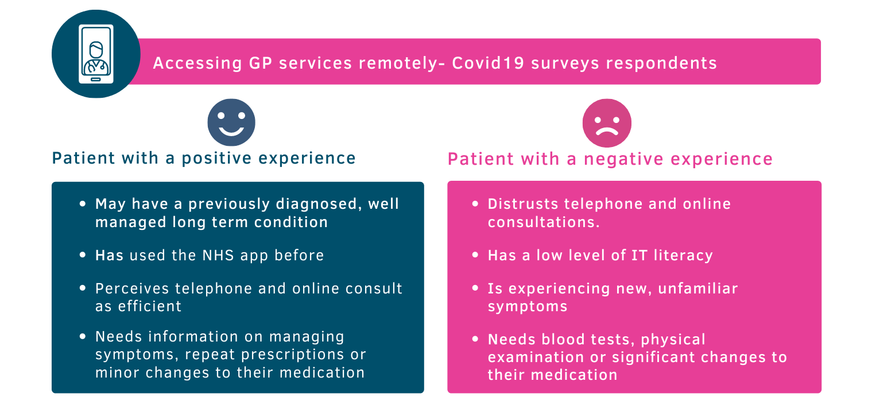
“Highlighting the strengths and downfalls of the Total Triage programme enabled us to make improvements before rolling it out at scale. This allowed GPs to respond more rapidly to a virtual appointment offer during Covid.” GP Care Group Quality Improvement Team
What has been most helpful is the work that Tower Hamlets Healthwatch have done to inform an adaptation of the ‘virtual by default’ patient offer to ensure that existing health inequalities were not worsened even further as a result of this approach. Practices are now identifying and coding this cohort of patients so that their service offer is adapted accordingly.“ Clinical Care Group
The project was highly commended in the Healthwatch England Awards 2020 for Improving Health and Social Care. It was highly commended in the HSJ Awards as a partner to our GP Care Group for Primary Care Innovation of the Year using our patient experience data to improve GP access to reduce waiting times.

Slide 13
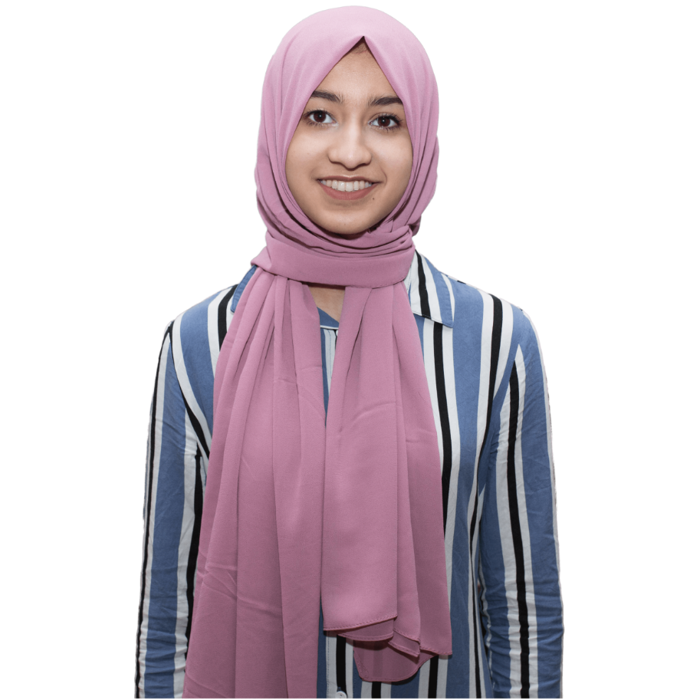
Then and now | Healthwatch Tower Hamlets | Annual Report 2020-21
Young people: then and now
The experience of young people during the pandemic.
We wanted to understand what the impact of periods of lockdown were having on local young people and what they were doing to cope.
Eleven young influencers (13-18 year olds) collected data from a total of 95 young residents, 56 identified as female and 39 identified as male, ranging from 11 - 21 years of age from a range of different ethnic backgrounds.
Findings
Impact
Mental health education should be introduced across schools to ensure young people learn about how to maintain their health and wellbeing.
Local Council are working with young people to develop an offer that teaches young people how to maintain their health and wellbeing. The Mental Health in Schools project is working to support pupils in several Tower Hamlets schools so they can get support for their mental health early on.
Resources for low income families
There has also been some success for the local campaign to address this issue. A £70,000 donation was made to buy books as well as a donation from the National Grid of 70 laptops that are being distributed to some schools. A high-profile communications push is being planned to attract more donations.
Criminal activity and youth violence continues to operated during Covid
The Young influencers have been informed that this work is being delivered by group of professionals with a specific focus on vulnerable children and exploitation, including, youth services, youth justice, social care, and the police. The group is continuing to meet regardless of the pandemic, so they can continue their important work.
Click on the image to read the full report.

Slide 14
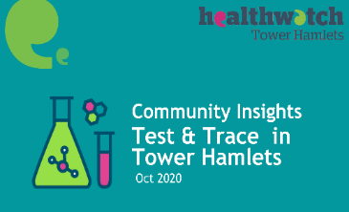
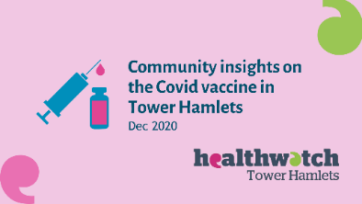
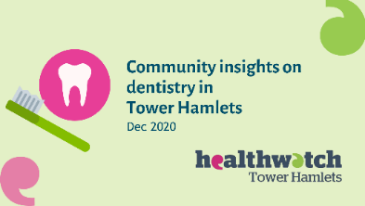
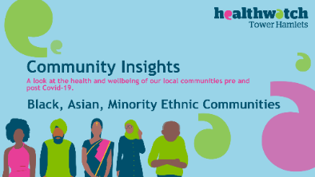
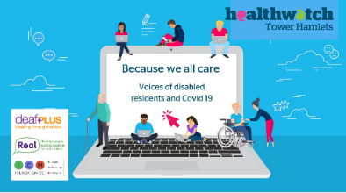
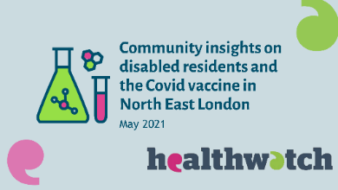
Then and now | Healthwatch Tower Hamlets | Annual Report 2020-21
Our community insights reports
As well as the reports already highlighted we have provided insights on a wide range of topics important to our local residents and partners.
You can find all of our reports on our website here. We provide regular dashboards on residents experience of GP Practices, the Royal London Hospital and on health and care services as a whole. This year we will be producing these quarterly with a clear summary of where things are working well and where further improvement may be needed. We are also working with our neighbouring Healthwatch to produce these across the North East London area. You can see an example here
We produced a number of rapid reports in 2020-2021 to help inform the test and trace and vaccine roll out and to respond to difficulties accessing dental services. Click on the images below to find out more.
You can see our response to the Black, Asian and Ethnic Minority Inequalities Commission below.
These are the first in a series of reports from our Voices of Disabled residents projects.

Slide 15
Volunteers
At Healthwatch Tower Hamlets we are supported by over a hundred volunteers to help us find out what people think is working, and what improvements people would like to make to services.
This year our volunteers:
Helped people have their say from home, carrying out surveys over the telephone and online.
Created digital content on our websites and social media.
Helped gather community insights from across social media and online to build a stronger picture of the impact of Covid on local residents.
Supported the submission of our Trusted Charity Mark Application by co-ordinating all of our governance polices and procedures.
Our young volunteers developed and ran their own project to understand the impact of Covid on young peoples mental health.
Thank you
We want to say a massive thank you to all of our volunteers who have helped us across all of the functions that we need to deliver. We also want to say a huge thank you to all of our residents that volunteered to fill in, what probably feels like, an endless number of surveys and feedback forms. We hope that this report reassures you that what you tell us does make a difference.

Slide 16
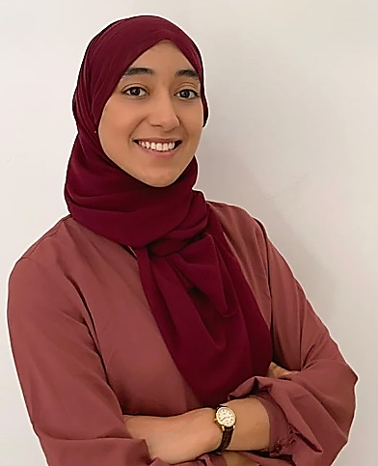
Community Insights Researcher- Flora
Working as a Community Insights Researcher has allowed me to learn about my community and understand people's varying circumstances, particularly during the challenging times the pandemic has brought. Participating in the research projects made me feel I was positively contributing to my community and making a difference in their lives. I have also been able to build new transferrable skills that will likely benefit me in my professional career.
Helping run the office - Maria
I am studying organisational psychology and was looking for volunteering experience that could include administrative skills related to my studies and potential future career. At Healthwatch I have improved my smart-working and team skills and developed an understanding of governance policies and procedures. I feel these skills will be useful for my future career.
Board member - Kate
I have been involved with patient and public involvement for many years. In part as a researcher exploring its evolvement but more importantly as a contributor to Healthwatch. Tower Hamlets. Healthwatch has a difficult remit in treading the delicate balance between a passion for supporting residents, meeting the demands of the CCG and local authority as well as ensuring that the most useful information reaches the right people at the right time. Health and social care is at yet another turning point and I hope as member of Healthwatch it will be possible to contribute to its future.
Volunteer with us
Are you feeling inspired? We are always on the lookout for new volunteers. If you are interested in volunteering, please get in touch at Healthwatch Tower Hamlets.
www.healthwatchtowerhamlets.co.uk
0800 145 5343
infol@healthwatchtowerhamlets.co.uk

Slide 17
Finances
To help us carry out our work we receive funding from our local authority under the Health and Social Care Act 2012.
Income
Expenditure

Slide 18
Next steps & thank you
Top three priorities for 2021-22
Voices of disabled residents. Understanding how changes to services, due to Covid, are impacting disabled residents and involving them in service redesign.
What’s changed. Make community views on what health and care services should look like post-Covid central to Borough decision making.
Delays in care. How can patients manage their care while they wait for treatment and how can administrative processes be improved, including online and phone, to support trust in the waiting process.
Two threads will run through all of our work this year – mental health and understanding and tackling health inequalities.
"Tackling unfair health differences will need those in power to listen. To hear the experiences of those facing inequality and understand the steps that could improve people’s lives, and then to act on what has been learned.“
Dianne Barham , Chief Executive. Healthwatch Tower Hamlets.
Building on the themes identified in our report on Home Care services (undertaken for us by local community organisation, Almost Any How) we will begin our first large scale co-production partnership with Tower Hamlets Together to re-procure the service. Click on the image to read this very thought provoking report.
We will continue to work with our neighbouring Healthwatch to expand and develop the Community Insights System as the primary tool for our statutory and voluntary sector partners to collect and share the insights from our local residents.
Thank you to our community partners
We would especially like to thank the voluntary and community organisations who have worked with us this year and made it possible for us to gather insights from residents that we may have found more difficult to reach.

Slide 19
Statutory statements
About us
Healthwatch Tower Hamlets, Wheel Chair Centre, Mile End Hospital, Bancroft Road, London E1 3AG.
Healthwatch Tower Hamlets uses the Healthwatch Trademark when undertaking our statutory activities as covered by the licence agreement.
The way we work
Involvement of volunteers and lay people in our governance and decision-making.
Our Healthwatch board consists of 12 members who work on a voluntary basis to provide direction, oversight and scrutiny to our activities. Our board ensures that decisions about priority areas of work reflect the concerns and interests of our diverse local community. Through 2020/21 the board met nine times and made decisions on matters such as to add gathering insights from care home residents and their friends and family to our work programme to replace enter and view visits and to look at increasing our resources by working collaboratively with the eight Borough NEL community insights project.
We ensure wider public involvement in deciding our work priorities by reviewing themes from all of the community insights gathered throughout the year including identifying groups we haven’t heard from. We draft a long list of priorities that we review with our stakeholders to see where we can best make a difference. We then ask our members to vote on the top three priorities through a member survey through our eBulletin.

Slide 20
Methods and systems used across the year’s work to obtain people’s views and experience.
We use a wide range of approaches to ensure that as many people as possible have the opportunity to provide us with insight about their experience of health and care services. During 2020/21 we have been available by phone, by email, provided a webform on our website, provided a feedback centre/rate and review system, attended virtual meetings of community groups and forums, provided our own virtual activities and engaged with the public through social media.
We are committed to taking additional steps to ensure we obtain the views of people from diverse backgrounds who are often not heard by health and care decision makers. This year we have done, for example, this by working with user groups who work with people with learning, visual and hearing impairments and by training local residents from within harder to reach communities such as our Somali and Eastern European residents to undertake phone interviews with people in their networks.
We ensure that this annual report is made available to as many members of the public and partner organisations as possible. We publish it on our website.
2020-21 priorities
Project / activity area | Changes made to services
Covid's impact on healthy communities. | The Borough health and wellbeing strategy has prioritised safe open spaces, children and young people and improving access and coordination of services.
Impact of increased digital access | Our profiling of likely excluded groups were used to train hospital and GP staff to help reach everybody in the community.
Disabled residents information and communication needs | Our report informed communication plans for vaccine uptake leading to improved messaging and likely better uptake.
Covid's impact on young people | The Council are working with young people to develop tools to help maintain their health and wellbeing.
Integrated Home Care | We are working with the NHS and the Council to design a new home care service.
Responses to recommendations and requests
We did not have any providers who did not respond to requests for information or recommendations.
This year, due to the COVID-19 pandemic, we did not make use of our Enter and View powers. Consequently, no recommendations or other actions resulted from this area of activity.
There were no issues or recommendations escalated by our Healthwatch to Healthwatch England Committee and so no resulting special reviews or investigations.
Health and Wellbeing Board
Healthwatch Tower Hamlets is represented on the Tower Hamlets Health and Wellbeing Board by our Co Chair Randal Smith. During 2020/21 our he has effectively carried our this role by: presenting the findings of our Community Insights on Covid; highlighting the voice of the digitally excluded and participating in the Local Engagement Board to provide community input into the Covid response.

Slide 21
Healthwatch Tower Hamlets
Wheelchair Centre
Mile End Hospital
275 Bancroft Road
London
E1 3AG
www.healthwatchtowerhamlets.co.uk
t: 0800 145 5343
e: info@healthwatchtowerhamlets.co.uk
@HWTowerhamlets
Facebook.com/Healthwatch-Tower-Hamlets

